Slide 1
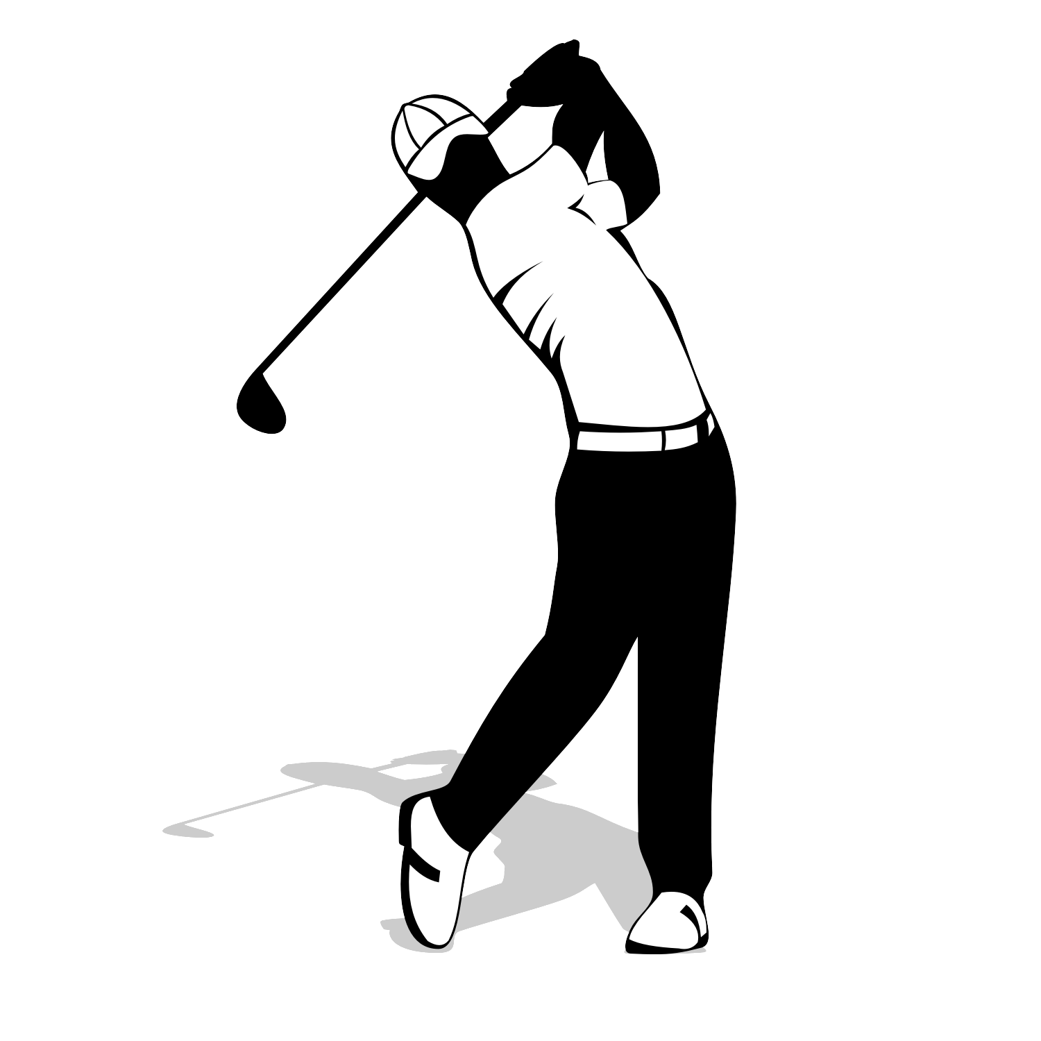
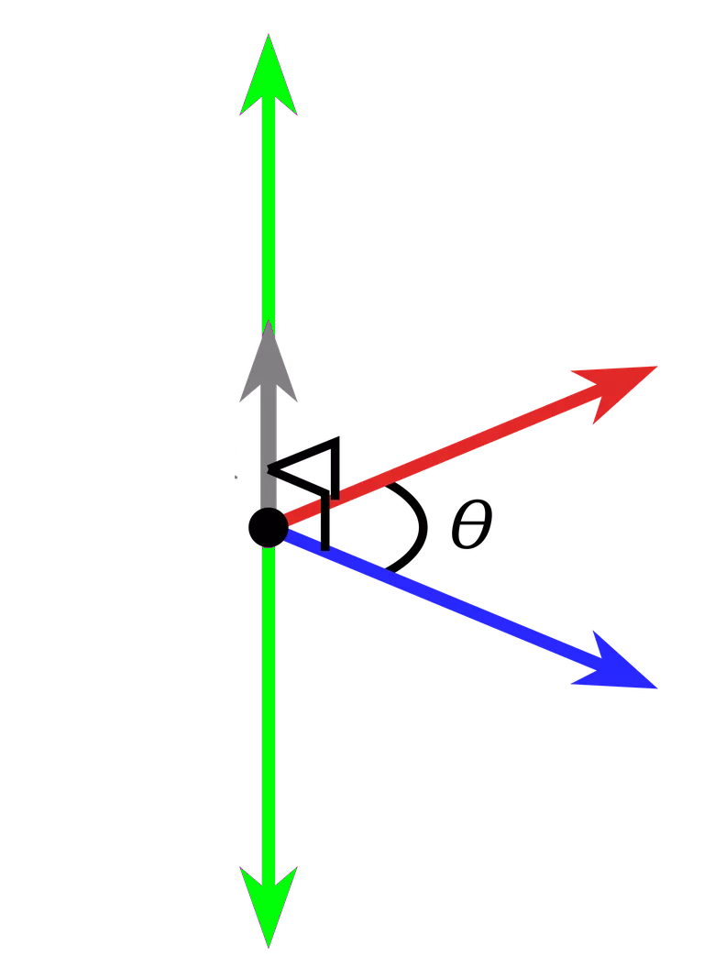

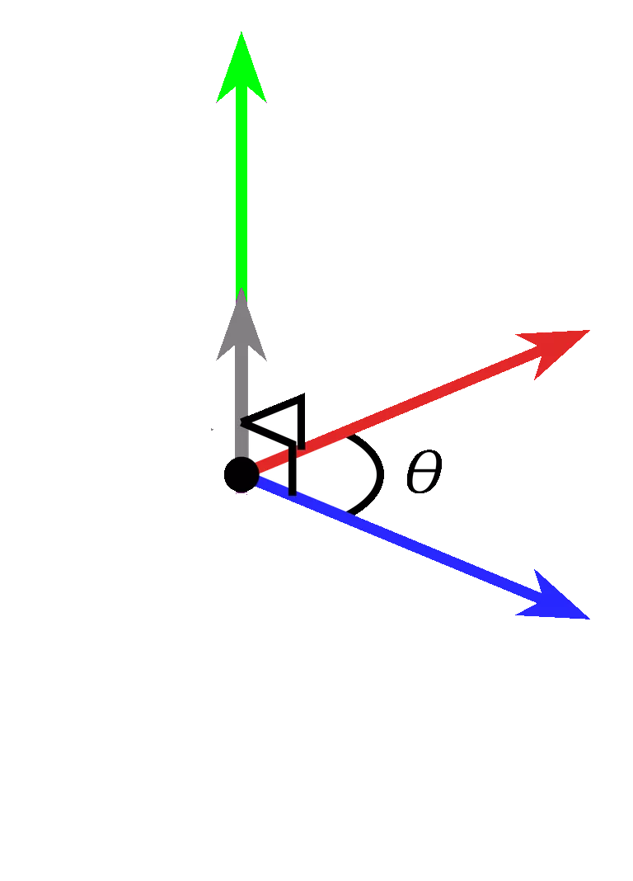
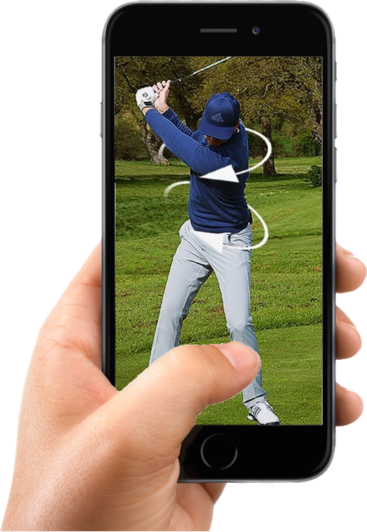
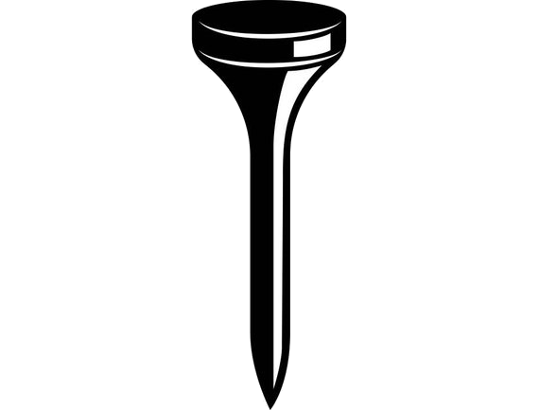
Golf Glove
Notes:
Cite yo shit

Slide 2
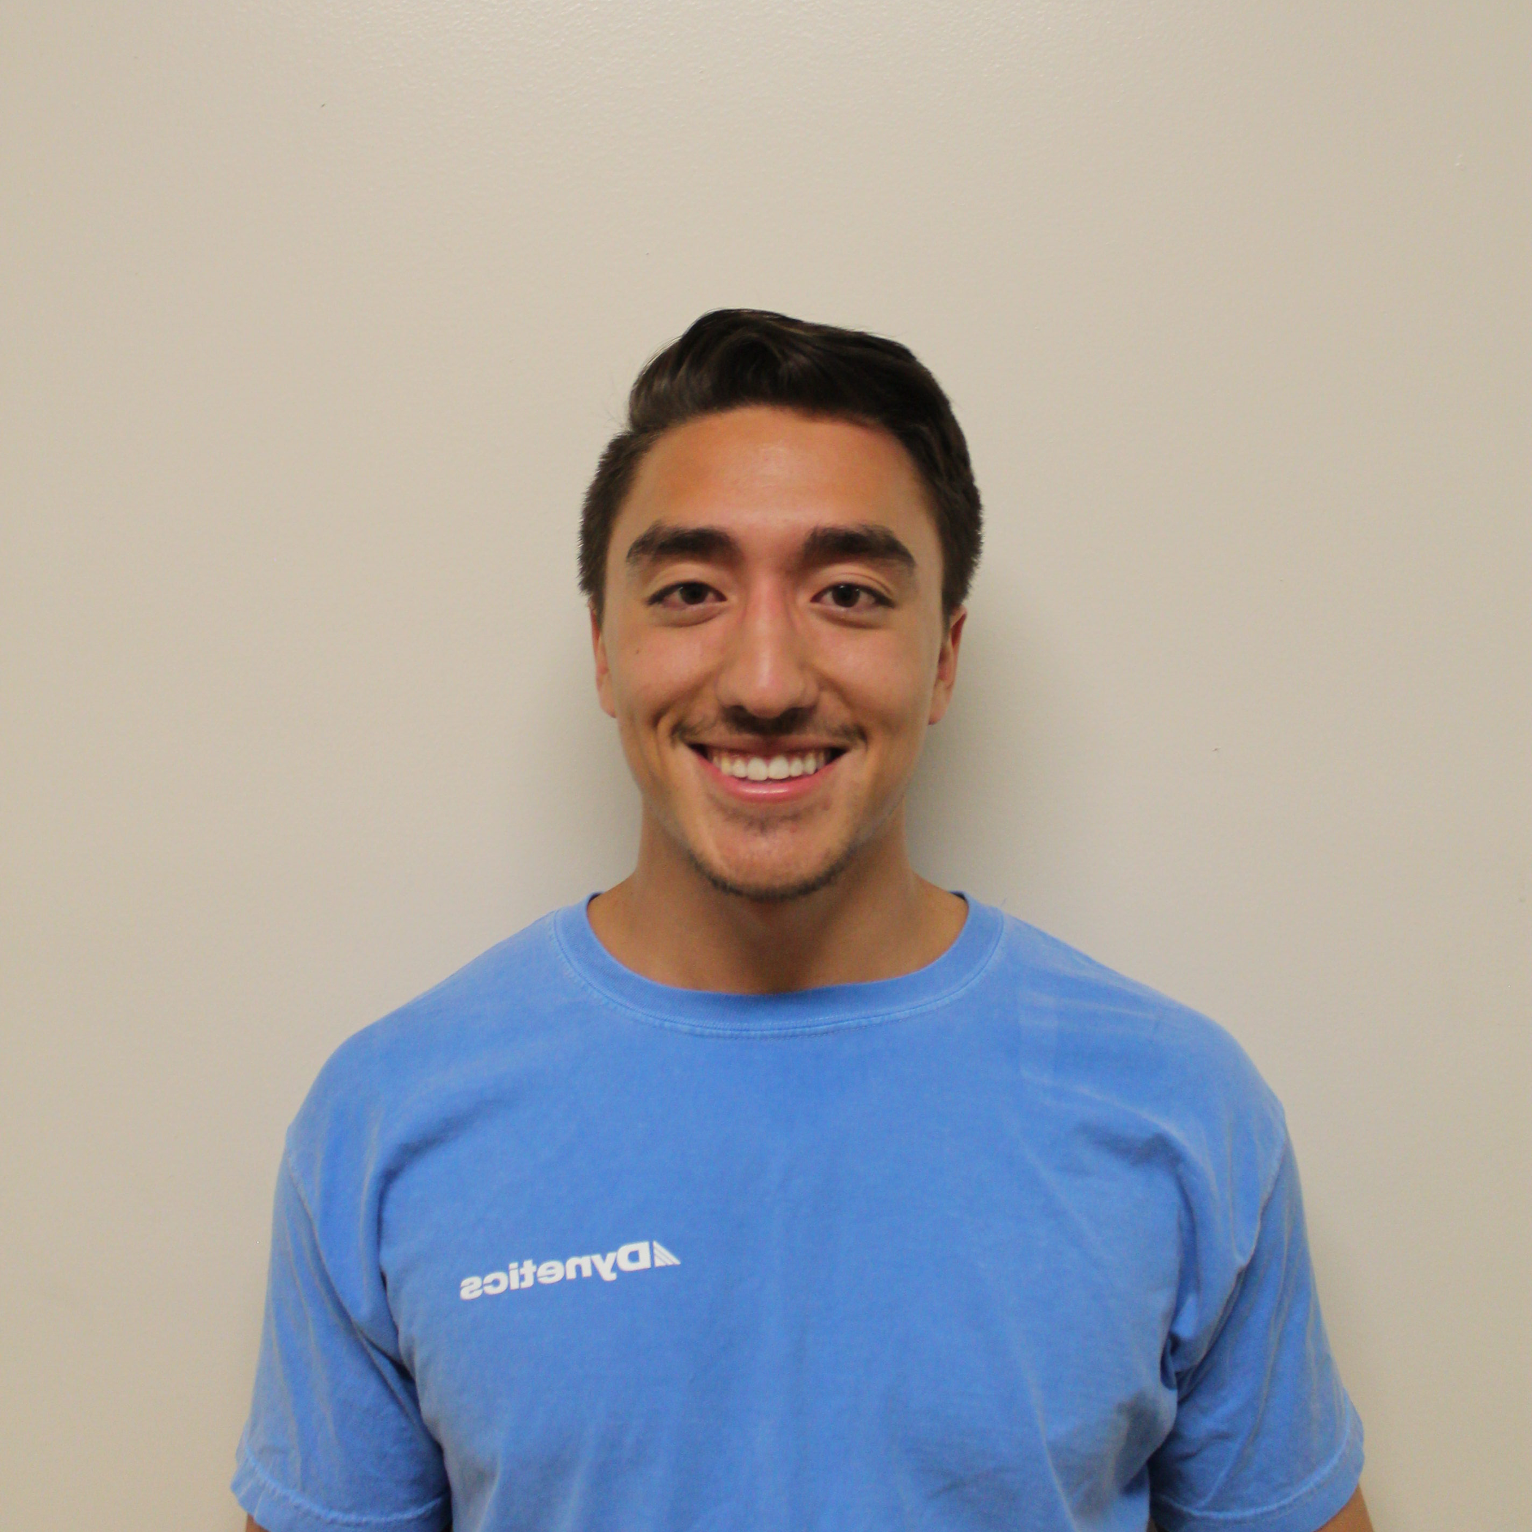
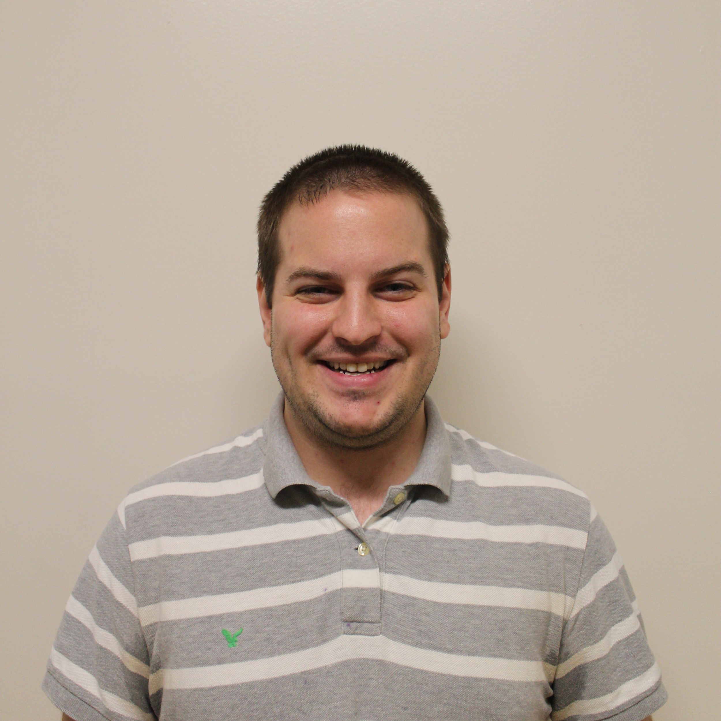
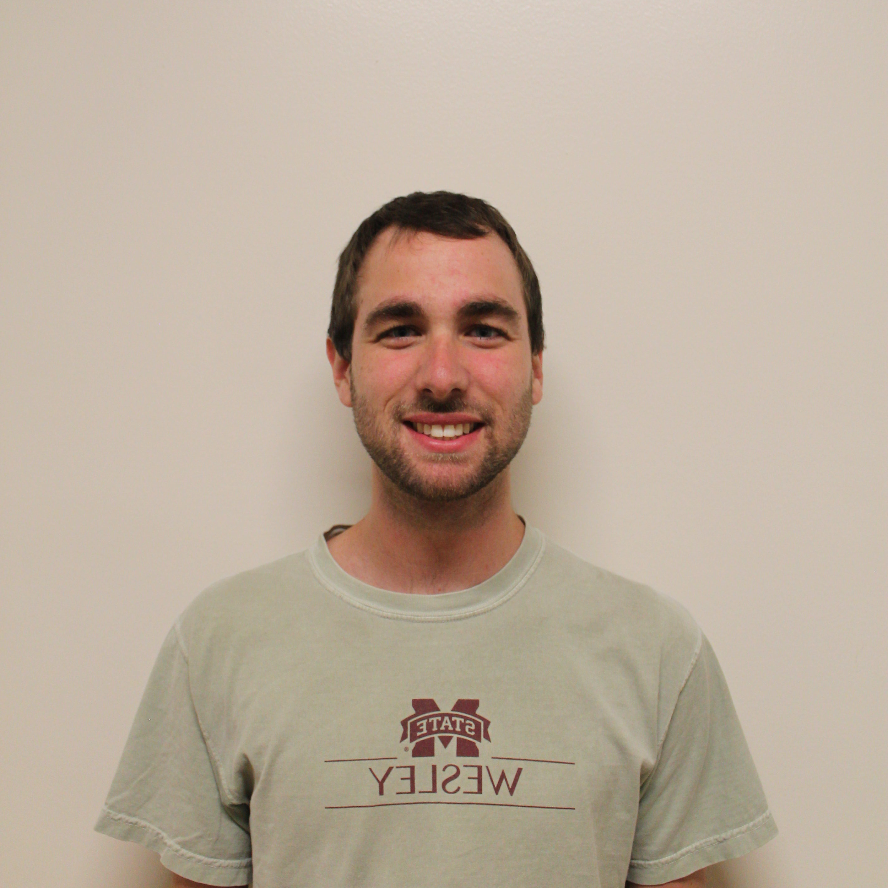
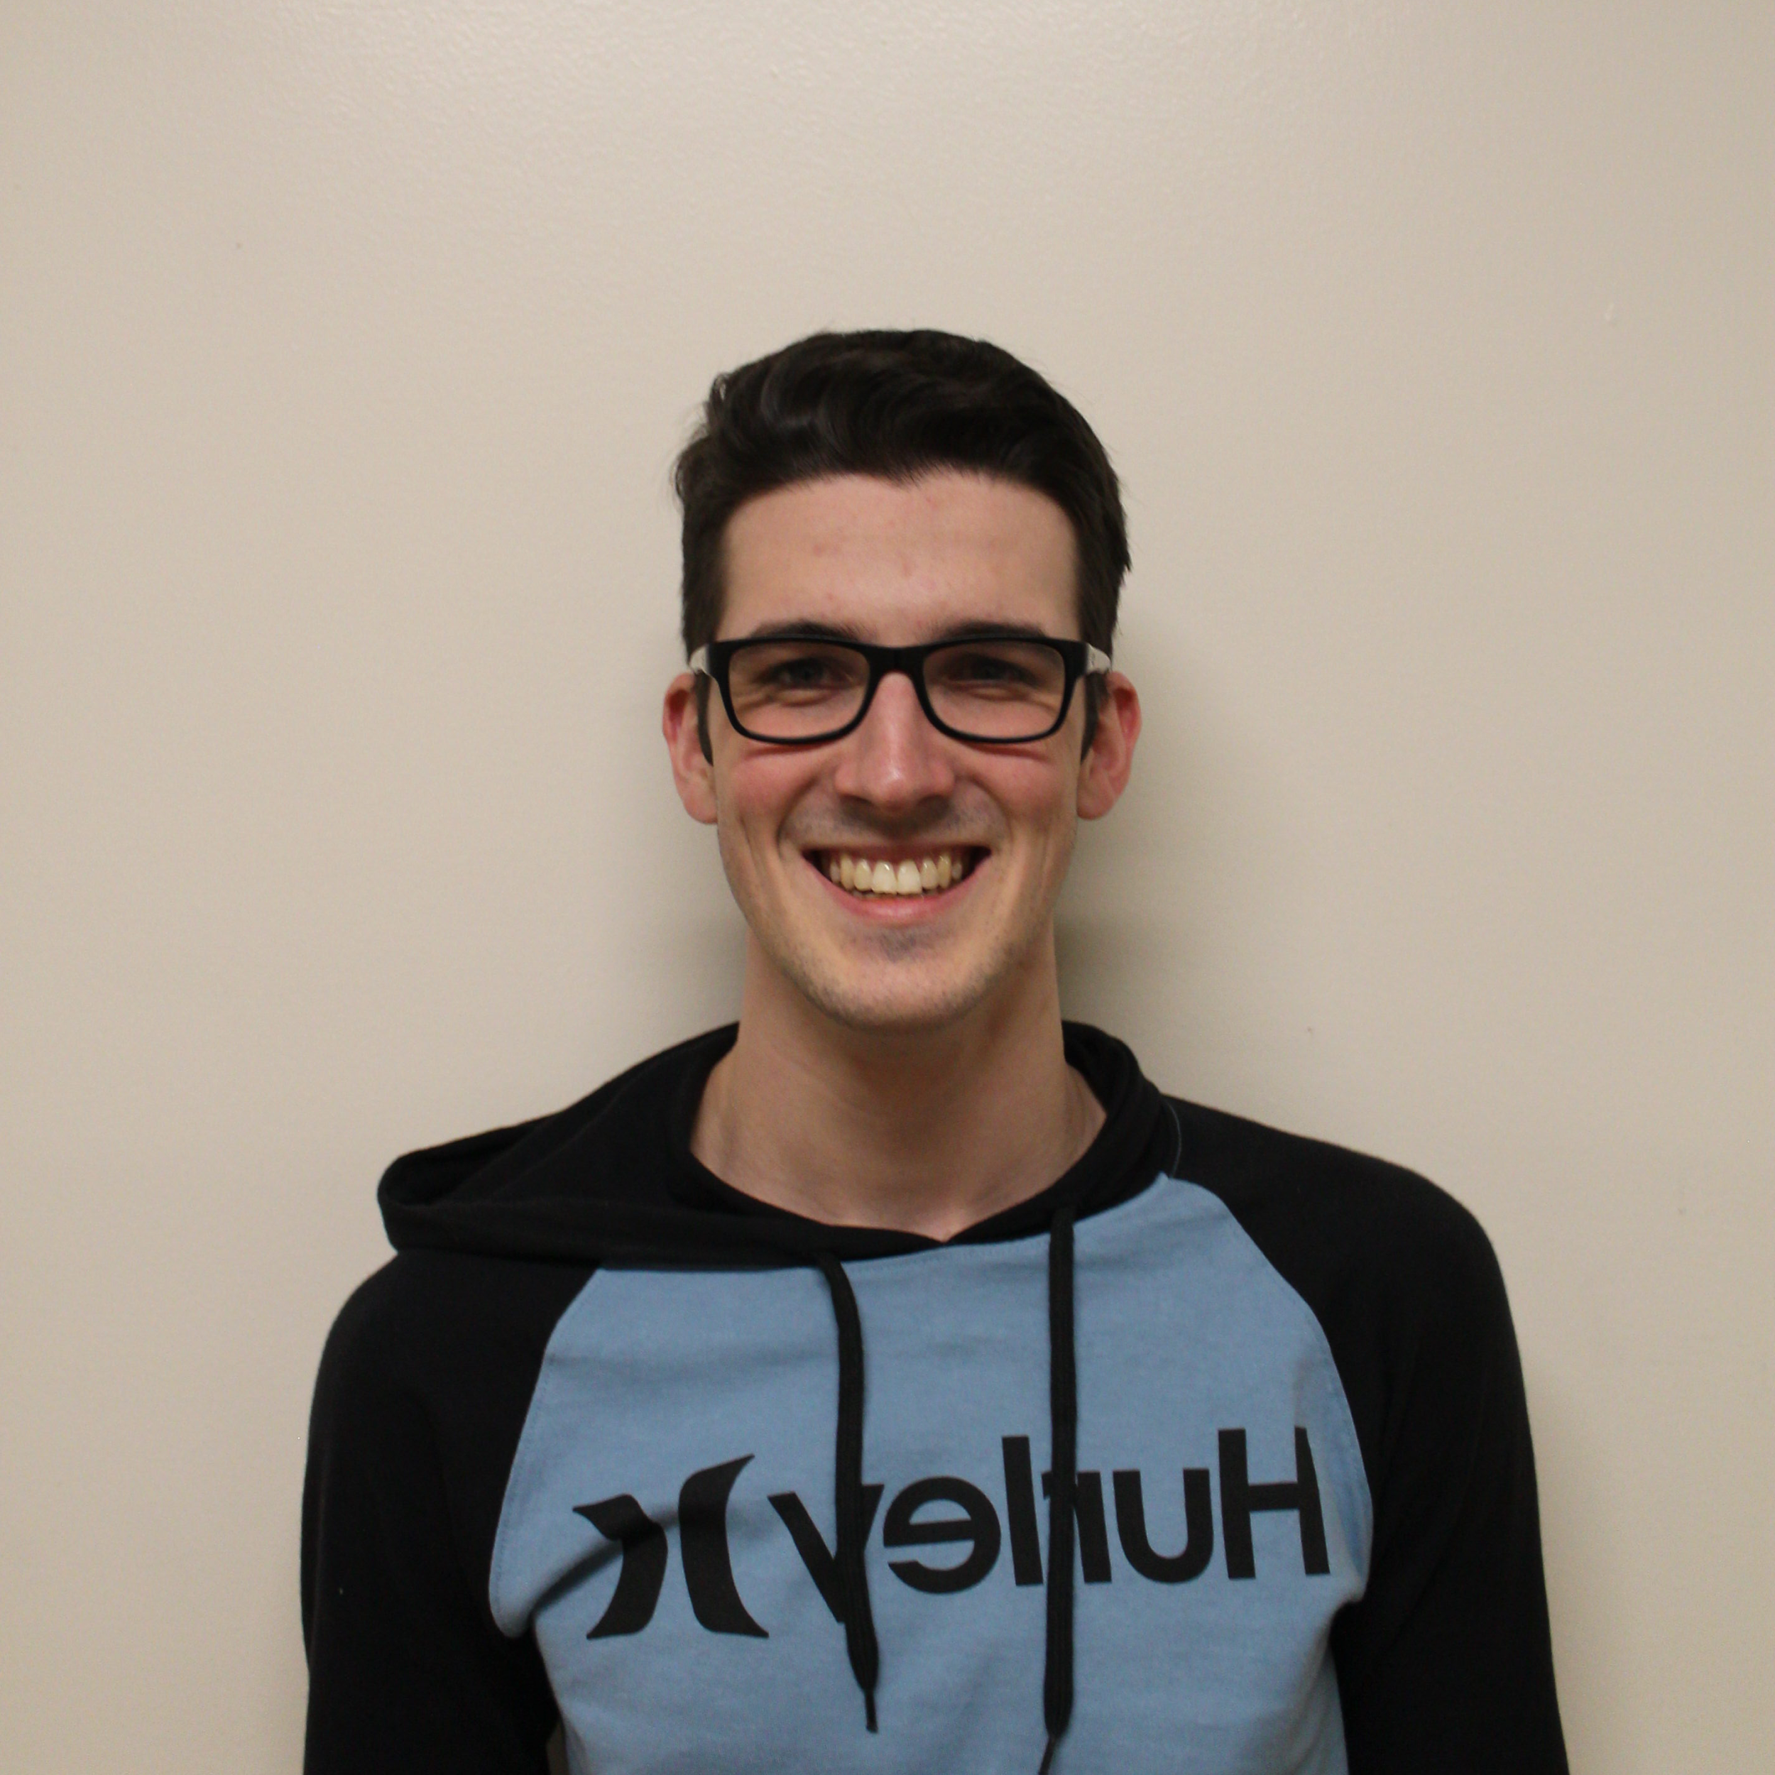
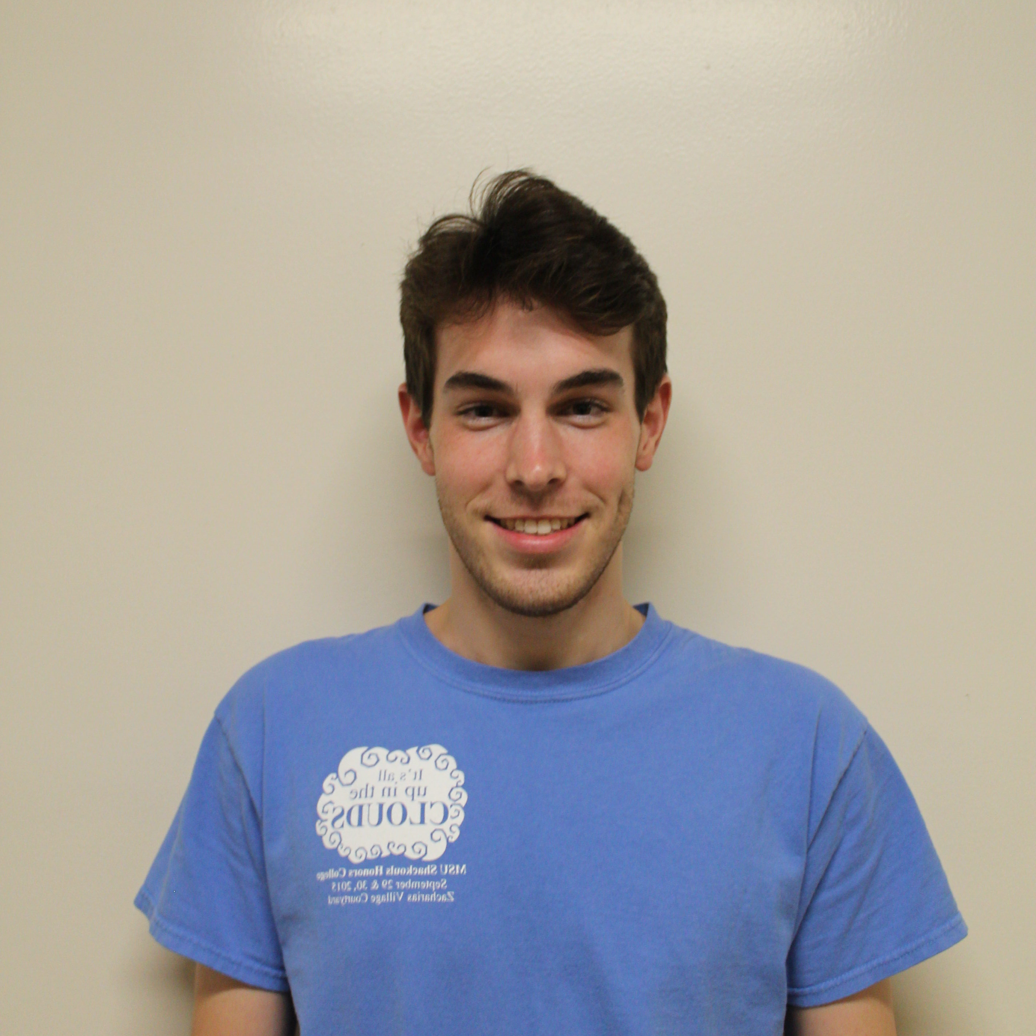
Team
Christian Bush
Computer Engineering
Software
Spencer Callicott
Computer Engineering
Firmware
Will Carroll
Computer Engineering Firmware
Landon Casey
Computer Engineering
Hardware
Jack Fletcher
Computer Engineering
Software
Notes:
Landon is the Man-don

Slide 3
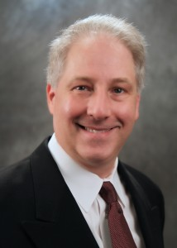
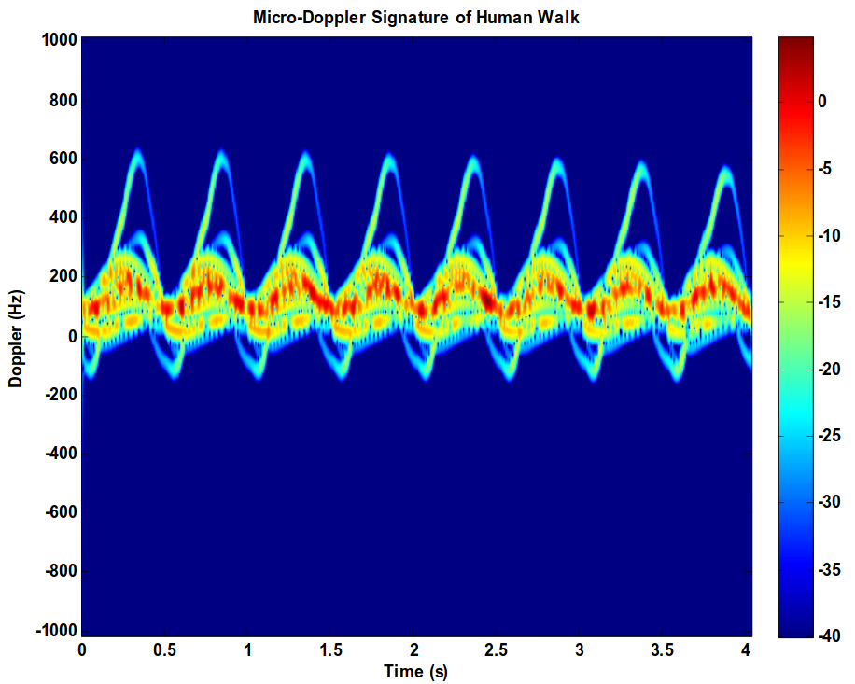
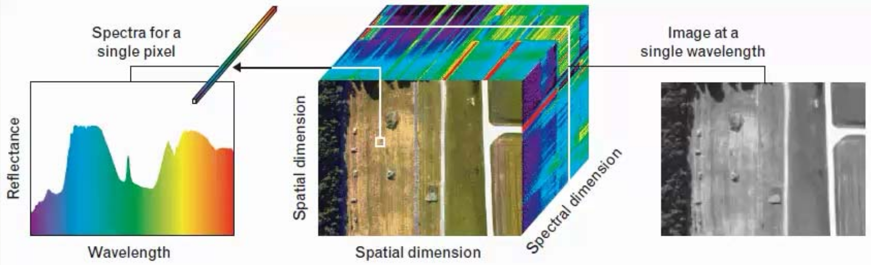
Advisor
Dr. John E. Ball
PhD, Electrical Engineering, Mississippi State University, 2007
MS, Electrical Engineering, Georgia Institute of Technology, 1993
Radar Systems
Digital Signal Processing
Digital Image Processing
Remote Sensing
Automated Target Detection
[1]

Slide 4
Presentation Outline
Problem Statement
System Overview
Design Constraints
Approach
Progress
Timeline

Slide 5
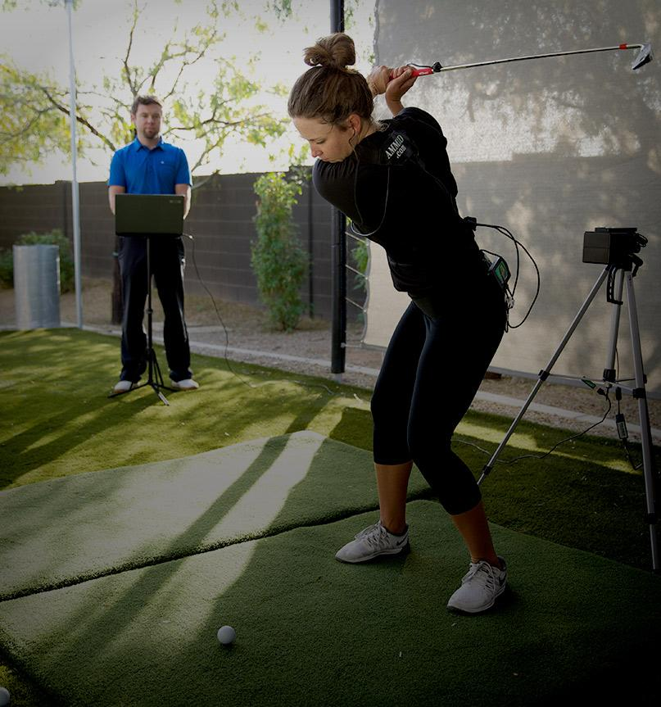
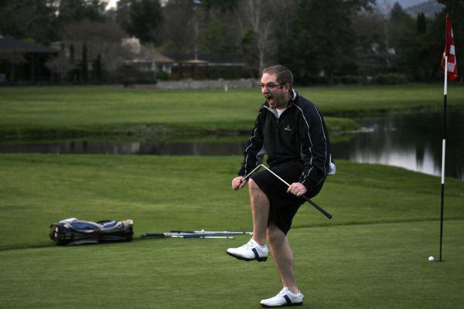
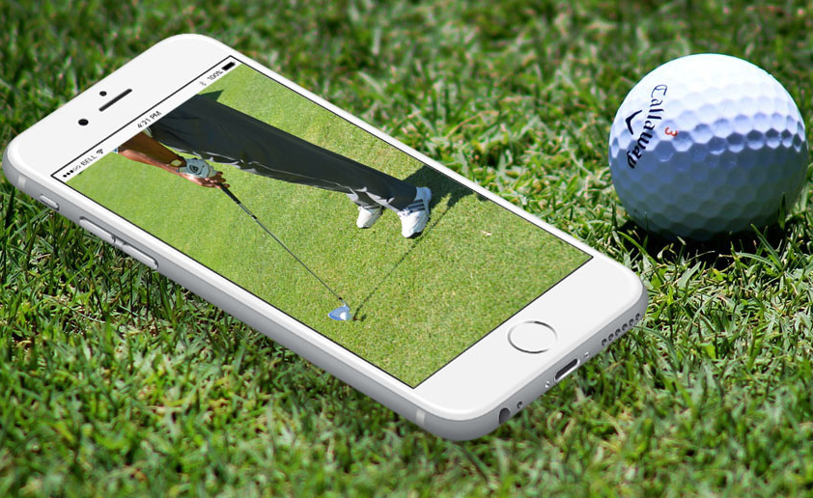
Problem Statement
Amateur Golf failures [2]
Next-generation coaching application [4]
Modern golf coaching technology [3]
Notes:
Landon
Golf has seen a recent upswing with millenials, who represent 36 percent of the nearly 24 million golfers in the United States. With 40.6 million Americans interested in golf, well over a third of that number “Around 15 million additional millennials expressed interest in taking up the game.” [x] -- https://www.cnbc.com/2017/08/12/millennials-breathing-new-life-into-golf-and-heres-how-the-industry-is-responding.html
Modern golf coaching often involves recording swings with high-speed cameras and accompanying accelerometer/position data. Performing analysis on this data is time consuming and requires a professional to be on-course reviewing the footage and giving tips.
Development has already started on the next generation of golf-swing coaching in the form of bluetooth position sensors paired with smartphone applications to give the user quick feedback based on comparing swing positioning to an ideal swing.
Golf Glove intends to build upon this approach by incorporating proprietary LiquidWire wearable stretch-sensors to measure wrist angles and correlate it with swing positioning data to provide the amateur golfer a high-resolution analysis of their swing technique.

Slide 6
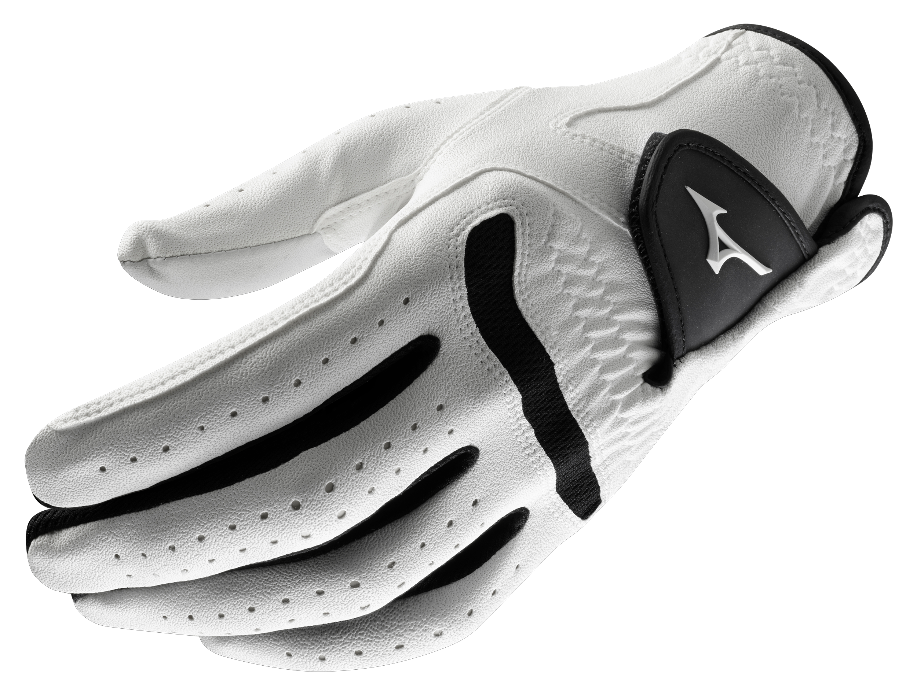
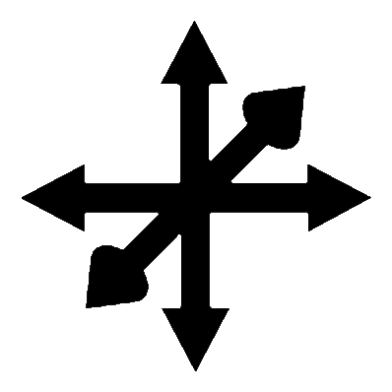
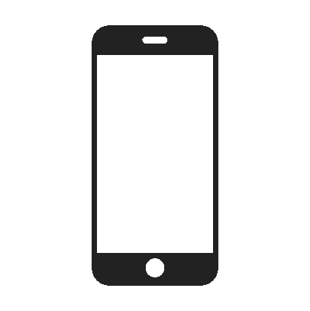

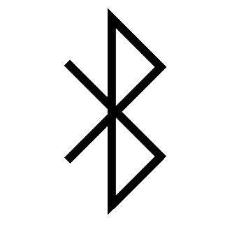

Product Specs
Accelerometer
Magnetometer
Controlled by app
Gyroscope
Wireless Communication
5-Hour Battery Life
Rechargeable
[5]
Notes:
Spencer
Our design consists of a coaching application that communicates with a glove and wrist-mounted assembly to record and analyze swing data.
Sensor data will be compiled from Accelerometers, Magnetometers, Gyroscopes, and resistive stretch sensors.
Our design intends to achieve a 5 hour battery life, since the average golfer can complete an 18-hole course within 5 hours.

Slide 7
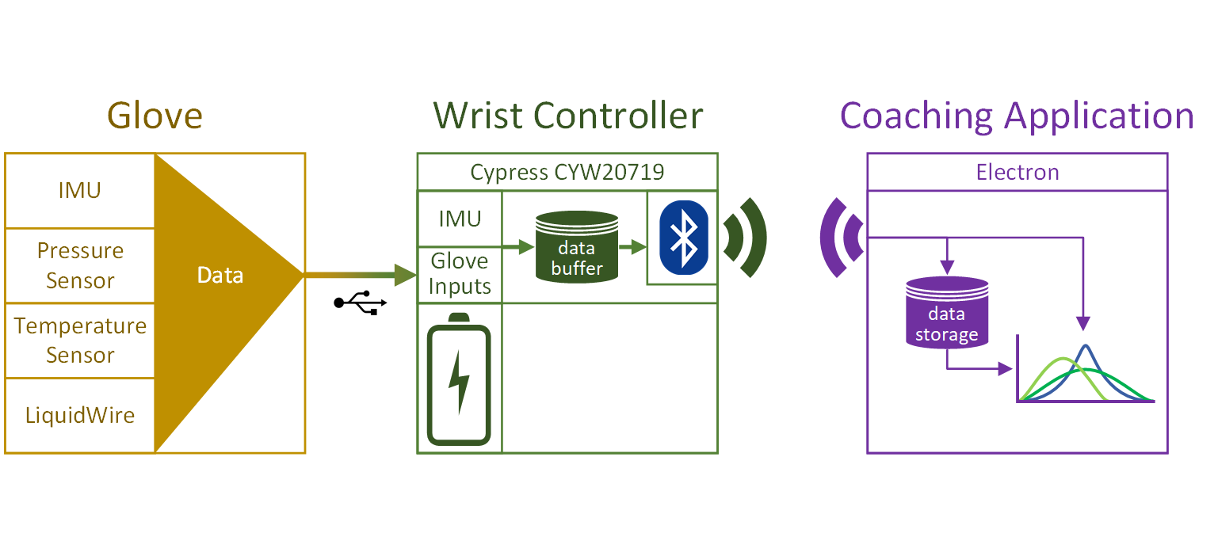
System Overview

Slide 8
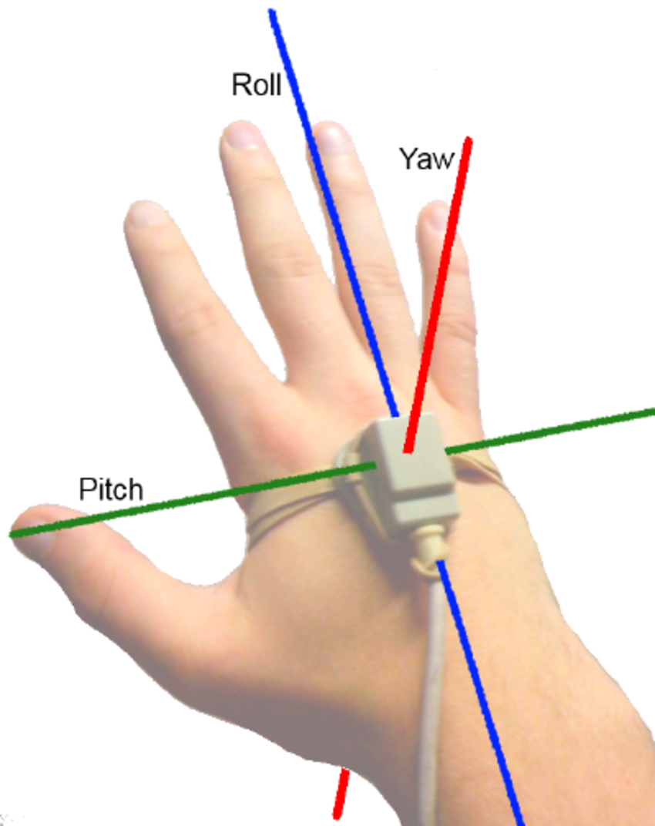
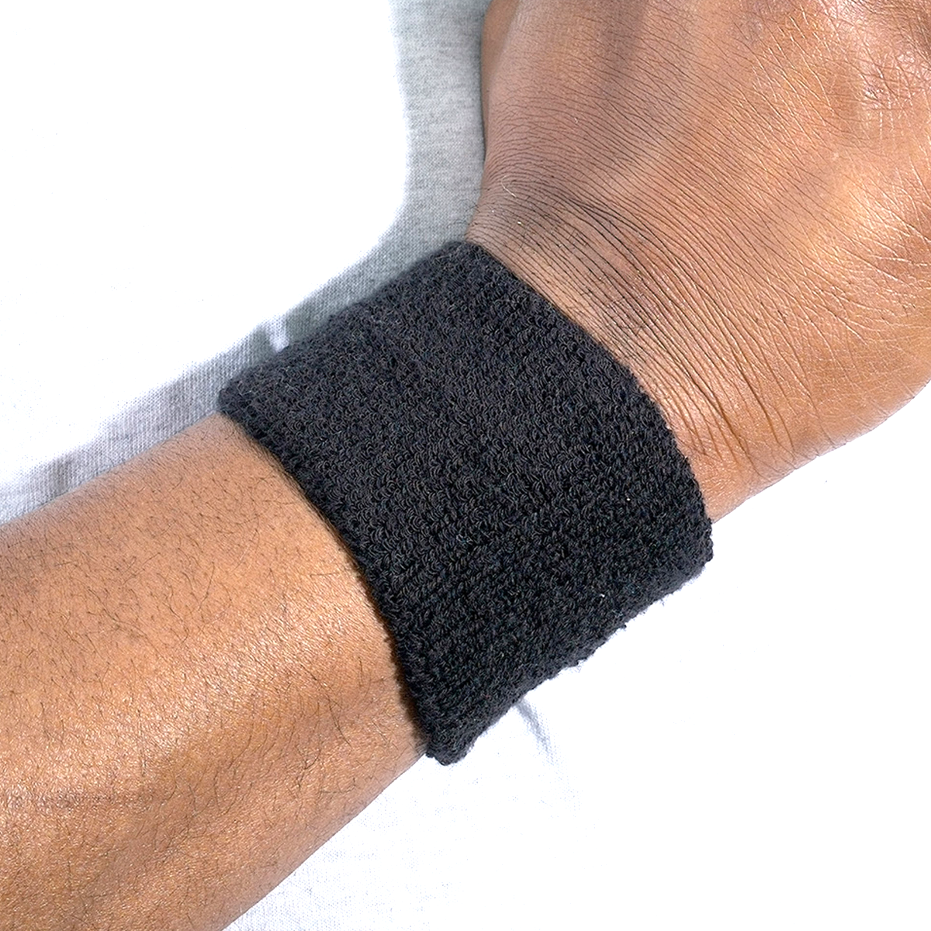
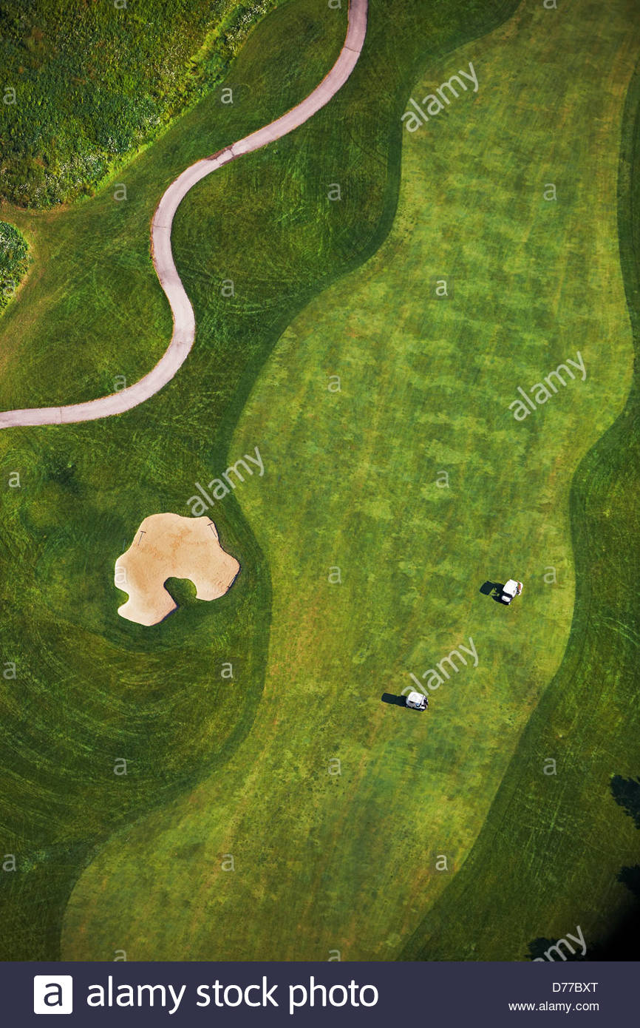
Design Constraints - Technical
Average Width
Accurate Orientation [6]
Wireless Communication [7]
Comfortable and Unobtrusive [8]
Cheetham P. (2014) The relationship of club handle twist velocity to selected biomechanical characteristics of the golf drive. Doctoral dissertation. http://gradworks.umi.com/36/32/3632464.html
Human-Media Interaction - Scientific Figure on ResearchGate. Available from: https://www.researchgate.net/The-users-hand-with-the-three-axes-and-the-names-of-the-orientation-around-these-axes_fig17_46720588 [accessed 1 Oct, 2018]
http://synapsebristol.blogspot.com/2012/12/batteries-breakthrough.html
Notes:
Our first technical constraint is measuring accurate hand, wrist, and forearm orientation. We must keep these metrics to 3° error, as well as constrain the hand velocity to 5% error in order to capture the swing correctly. This will allow us to measure the club head location to within ½ of its own length and the velocity to within 1.2 m/s
For the wireless communication, our glove needs to connect and transmit to the receiver from 35 feet away to allow the user to cross an average tee box.
The wrist mounted controller must also be comfortable and unobtrusive. Our design must be smaller than the average size of a wrist sweatband, which is 3 inches in width.

Slide 9
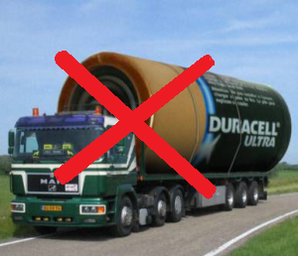
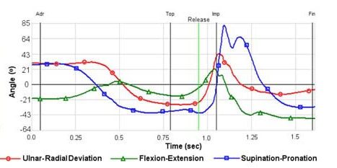
Design Constraints - Technical
Intuitive Display [9]
Portable [10]
Notes:
Our display must show the user’s wrist stretch and hand orientation, as well as allow the user to choose between “live” and “recorded” options.
The system must be portable: meaning no lengthy wires and powered by a battery.

Slide 10


Design Constraints - Practical
Cost [11]
Weather-resistant [12]
Swing Form
Notes:
Spencer
Cost has been identified as an important component to enabling millennial golfers to participate in the sport, with over 50% interested in cost-effective pay-as-you-go club memberships. We intend to keep the price of the Golf Glove under $200, to match competitor coaching solutions currently on the market.
The weather conditions cannot be controlled when playing a round of golf outdoors. Our design will be dust, water, and sweat-proof to enable it to be used rain or shine.
The most important aspect of the golf glove is improving golfer’s technique. By measuring wrist angles, speed, and pressure during a golfer’s swing, we can provide them with critical information about proper technique. For example, the pressure readings found in the top and bottom half of the palm can identify habits attributed to accelerating Tennis Elbow in golfers.

Slide 11

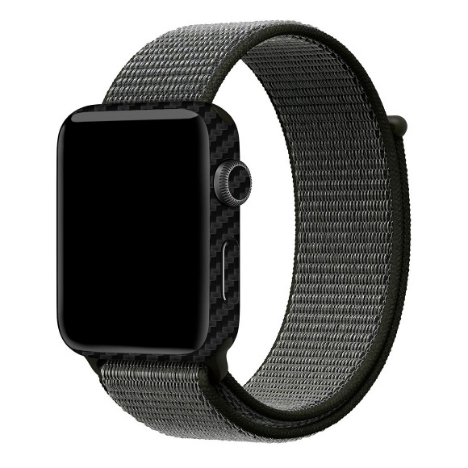
Design Constraints - Practical
Modular/Replaceable parts [13]
5 Hour Battery Life, Rechargeable
Notes:
Spencer
The golf glove will also be modular to promote easy replaceability.
It will sport a 500mAh battery that will power the glove for 5 hours of constant use.

Slide 12



Design Constraints - Engineering Standards
Ingress Protection Level 54 [14]
ICNIRP RF Emissions [15]
Reduction of Hazardous Substances [16]
Notes:
Spencer
To be weather resistant, the golf glove must adhere to Ingress Protection Level 54. IP54 defines that the operation of the glove and wrist-mounted controller must not be affected by dust or water. In short, both components will continue to operate in wet or dusty conditions.
We also identified a standard for wireless electromagnetic emissions that defines a standard for wearable technology to not exceed 4 W/kg. This will ensure that the device will not cause harm through the wireless communication that it uses.
Lastly, we will keep the design RoHS compliant. The European Union identified several harmful materials commonly used in electrical and computer engineering and compiled a list in the RoHS directive. We will ensure that our final design doesn’t contain any of the materials on the list to keep from harming the user.
Lead (Pb) Mercury (Hg) Cadmium (Cd) Hexavalent chromium (Cr6+) Polybrominated biphenyls (PBB) Polybrominated diphenyl ether (PBDE) Bis(2-ethylhexyl) phthalate (DEHP) Butyl benzyl phthalate (BBP) Dibutyl phthalate (DBP) Diisobutyl phthalate (DIBP)

Slide 13
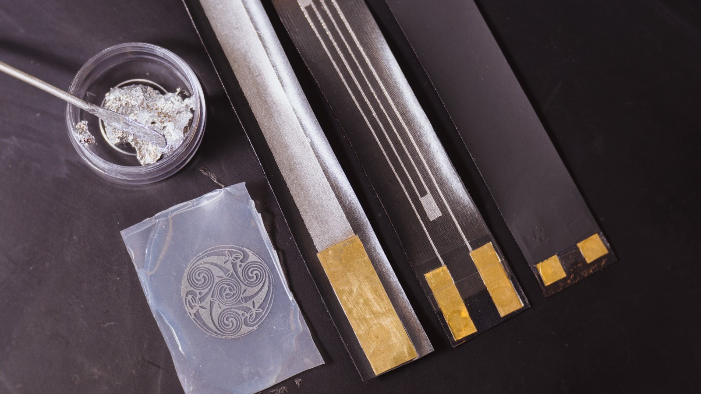
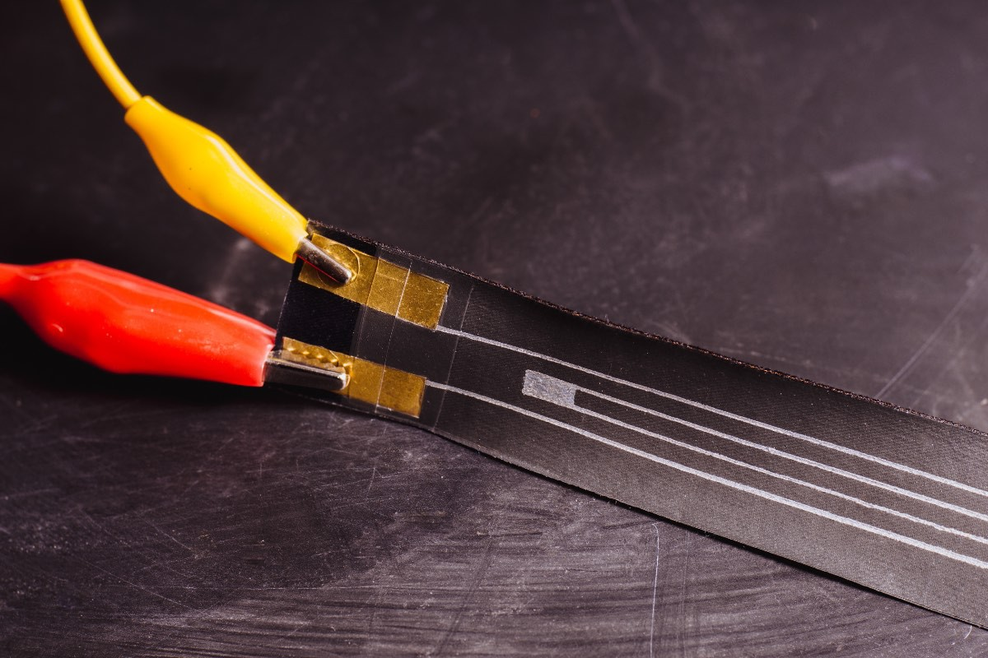
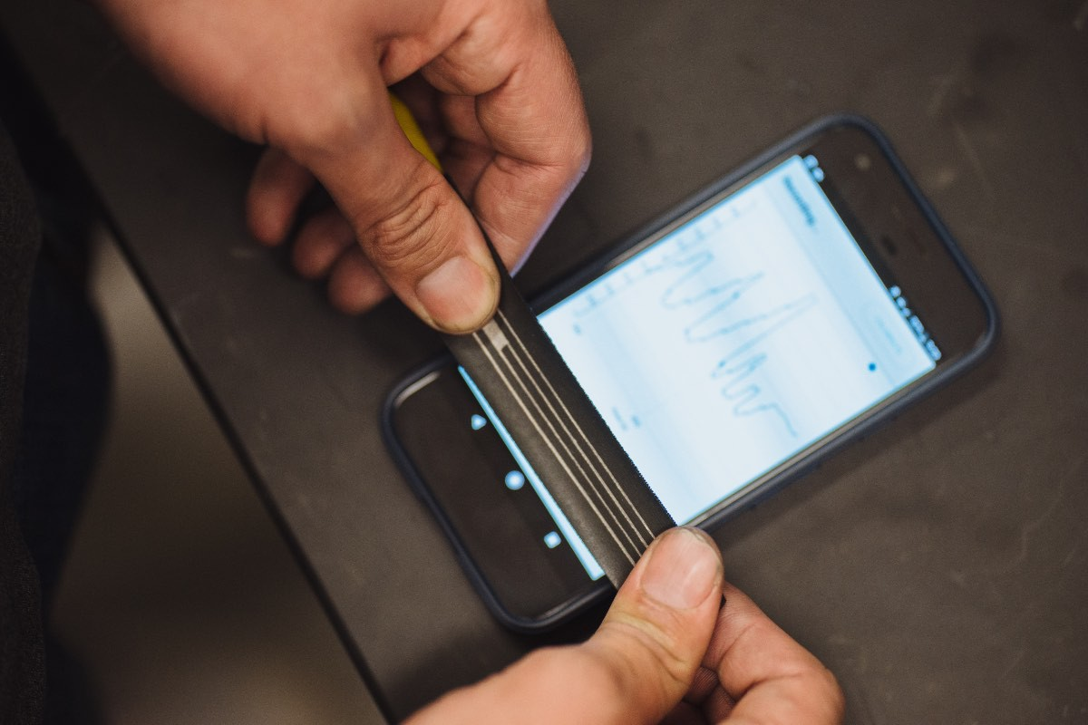
Approach: Hardware
LiquidWire Linear Soft Robotic Sensors [17]

Slide 14
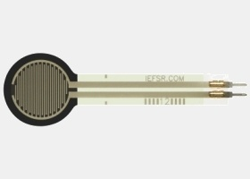
Approach: Linear Pressure Sensor
[18]
Name | Diameter (mm) | Price (USD) | Resistance Range (Ohms) | Interface/Communication
Interlink 40X | <15 | 7 | Infinite-250 | Analog
Velostat Conductive Sheet | Custom | 3.95 | Variable | Analog

Slide 15
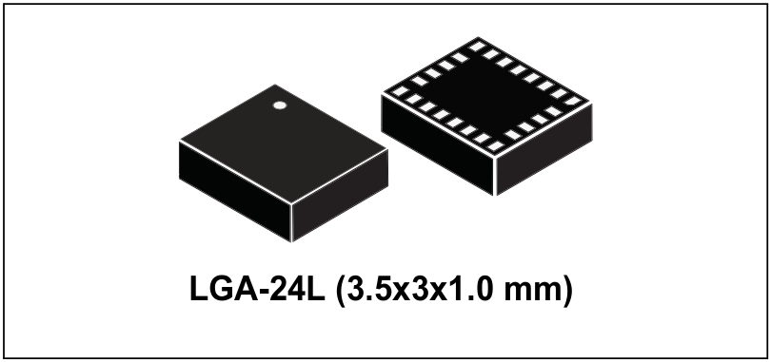
Approach: Inertial Measurement Unit (IMU)
IMU | Cost (USD) | Power Draw (mA) | Accelerometer/Gyroscope | Magnetometer | Interface
STM LSM9DS1 [21] | $ 6.14 | 4.6 | ±16g linear acceleration, ±2000dps angular rate | ±16 gauss | I²C / SPI
Bosch BMX055 [22] | $ 7.02 | 0.13 | ±16g linear acceleration, ±2000dps angular rate | ±2500 uT | I²C / SPI
[23]

Slide 16
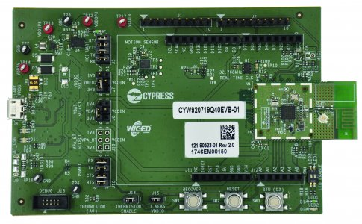

Approach: Microcontroller
Microcontroller | Cost (USD) | Wireless Connectivity | Power Draw (mA) | Flash Memory (kB) | ADC
Cypress CYW20719 | $ 9.63 | BR/EDR/BLE Bluetooth 5.0 @ 2 Mbps | 10 mA | 1024 | 1 x28-channel, 10-bit, 3.6 ksps
Microchip IS1871 | $ 2.98 | BLE Bluetooth 5.0 | 8 mA | 256 | 1 x6-channel
CYW920719Q40EVB-01 Evaluation Board [19]
[20]

Slide 17
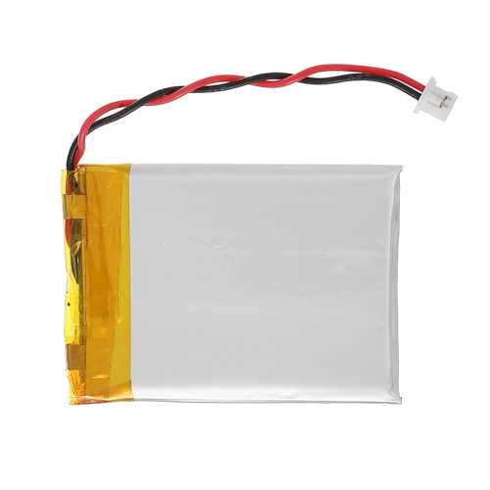
Approach: Battery
Component (Battery) | Price (USD) | Capacity (mAh) | Output Voltage (V) | Form Factor | Chemical Composition | Rechargeable
LP503035 | 1.00 | 500 | 3.7 | Pouch Cell | Li-Ion Polymer | Yes
UxCell AAA | 1.64 | 500 | 1.2 | AAA Cylinder | Ni-MH | Yes
Duracell AAA | 0.55 | 541 | 1.5 | AAA Cylinder | Alkaline | No
Panasonic CR3032 | 2.45 | 500 | 3.0 | Coin Cell | Lithium | No
Total Power Usage:
(I/O pins) + (Radio) + (IMUs) =
320mAh + 57.5mAh + 46mAh + .03mAh = 423.53mAh
500mAh 3.7V Li-Po Cell [24]
Notes:
Landon

Slide 18
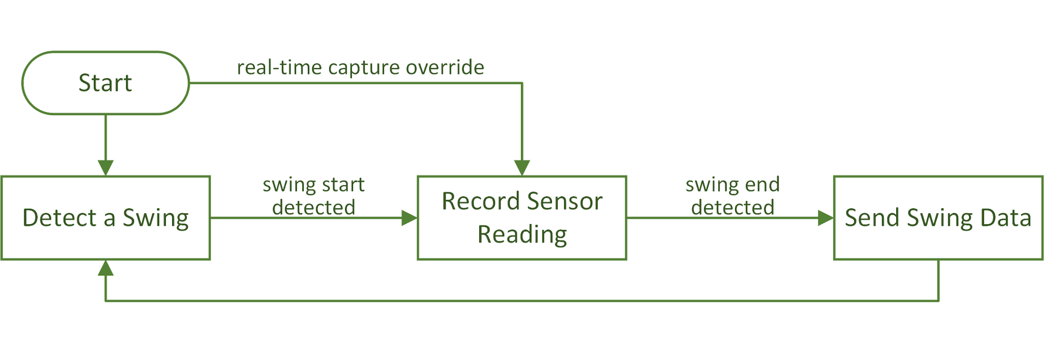
Approach: Firmware
Notes:
Spencer
The firmware will have two modes and three main states that it will loop between.
The first mode is swing-detection mode. In this mode, the microcontroller will wait for sensor delta values to reach a specified threshold to begin recording a swing. Delta values will be calculated as the difference between the last recorded value and the current reading at a rate of 100hz. When a swing is detected, the microcontroller will record the sensor data to internal flash memory at a rate of 100hz. Once completed, the microcontroller will try to push the swing data out of the queue to the coaching application device.
The second mode is real-time data capture mode. Sensor data will be queued and sent to the coaching application as it is read at a rate of 100hz. The swing detection logic will be overriden in this case and set to always true so that a “swing” appears as a single data point.

Slide 19
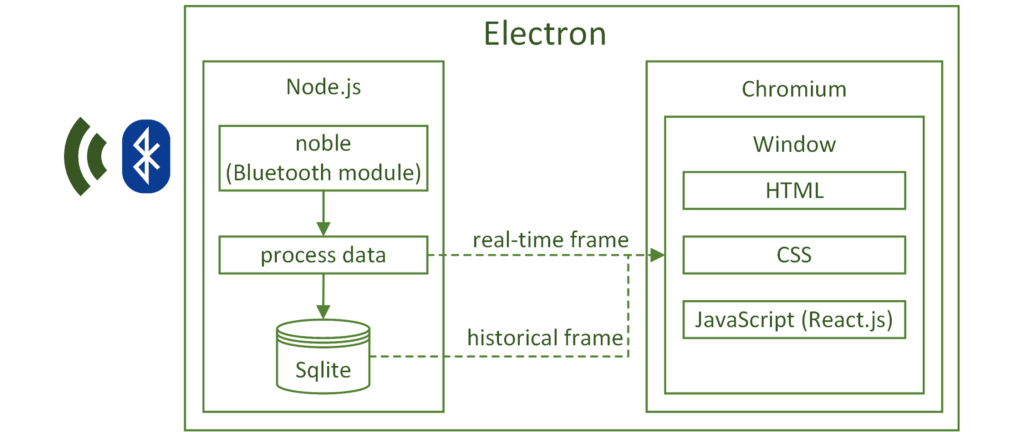
Approach: Coaching Software
Notes:
Our desktop software will use the Electron desktop application framework which consists of a Node.js server and the Chromium render engine (the same one in Google Chrome). The Node.js server will control the backend processes from the bluetooth connection and data reception, data processing and storage. In the normal operating mode, the data will be processed and then stored in a database for future viewing. In live mode, the data flow will be sent concurrently to the database and to the visualization window to populate it real-time information.

Slide 20
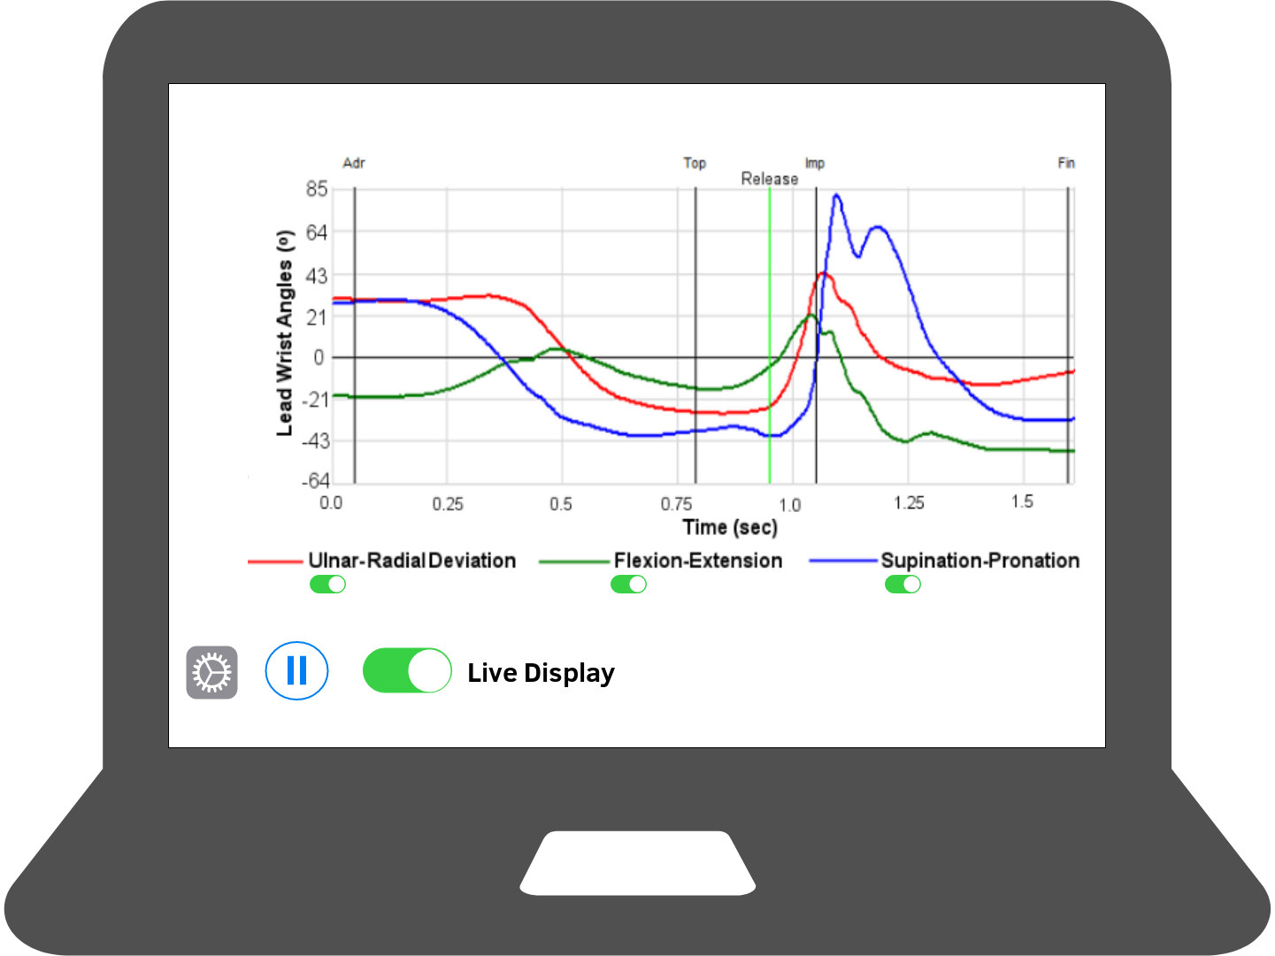
Approach: Front End

Slide 21
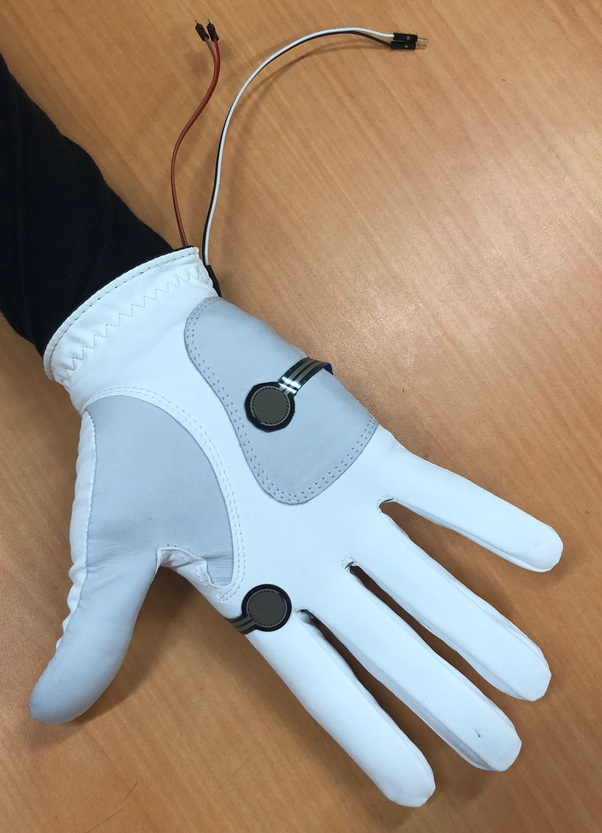


Progress
Garment
Pressure Sensor, IMU, Microcontroller
LiquidWire Sensors
Firmware Development
Software Development

Slide 22
Timeline
June 2018
September 2018
Late October 2018
November 2018
December 2018
Project Description and Proposal
Finalize Project Requirements and Order Parts
Subsystem Communication Prototype
Data Flow Prototype and System Testing
Final Design Prototype Completed
Notes:
Project Description and Proposal:
- Discussed project with Dr. Ball and Tony Luczak.
- Completed project proposal and received approval.
Finalized Project Requirements and Ordered Parts:
- Set project requirements using input from advisors.
- Ordered parts for testing and prototyping.
Subsystem Communication Prototype:
- Understand the methods used to communicate between systems (especially Bluetooth) and implement them.
Data Flow Prototype and System Testing:
- Appropriate and required data is correctly read by the system and is being send over correct communication channels. Begin testing system as a whole.
Final Design Prototype Completed:
- Project is completed and all systems meet requirements.

Slide 23
References
[1] Introduction to DSP (2018). https://mycourses.msstate.edu/bbcswebdav/pid-1559018-dt-content-rid-26818521_1/courses/jeb234.201830.Group01/Module_1.1_Introduction_Student.pdf [online].
[2] Ebaums World (2018). http://cdn.ebaumsworld.com/mediaFiles/picture/604025/84404810.jpg. [image].
[3] Exos (2018). https://www.teamexos.com/wp-content/uploads/2016/10/Hero_Capabilities_Golf.jpg. [image].
[4] Anadea (2018). https://anadea.info/uploads/image_attachment/image/1123/xCoaching_app.jpg.pagespeed.ic.eLjZbd84p6.jpg [image].
[5] 3 Golf Swing Death Moves With the Driver (2018). https://www.youtube.com/watch?v=QwhPr_0ZaIg [video].
[6] Hand Orientation Axes (2018). https://www.researchgate.net/figure/The-users-hand-with-the-three-axes-and-the-names-of-the-orientation-around-these-axes_fig17_46720588 [image].
[7] Aerial Golf Course Fairway (2018). https://www.alamy.com/stock-photo-aerial-view-golf-course-showing-sand-trap-fairway-golfers-golf-carts-56096736.html [image].
[8] Absorptive Moisture Wicking Sweatband (2018). https://www.amazon.com/Chill-Its-6500-Absorptive-Moisture-Wicking-Sweatband/dp/B002060PBQ [image].
[9] Cheetham P. (2014) The relationship of club handle twist velocity to selected biomechanical characteristics of the golf drive. Doctoral dissertation. http://gradworks.umi.com/36/32/3632464.html
Human-Media Interaction - Scientific Figure on ResearchGate. Available from: https://www.researchgate.net/The-users-hand-with-the-three-axes-and-the-names-of-the-orientation-around-these-axes_fig17_46720588 [accessed 1 Oct, 2018]
[10] Synapse Bristol (2018). http://synapsebristol.blogspot.com/2012/12/batteries-breakthrough.html [online].
[11] Ubisafe (2018). https://ubisafe.org/explore/costing-clipart-cost-optimization/#gal_post_1675_costing-clipart-cost-optimization.jpg. [image].
[12] Made in the Shade Hammocks. https://www.madeintheshadehammocks.com/product_images/uploaded_images/las-all-weather-hammock.png. [image].
[13] Slickwraps (2018). https://www.slickwraps.com/media/catalog/product/cache/1/image/580x580/9df78eab33525d08d6e5fb8d27136e95/a/p/apple-watch-series-3_carbon_black_1.jpg [image].

Slide 24
References - Cont.
[14] ProfessionalLine (2018). https://www.professionalline.com/temp/explorer/files/products/fr-CH/images/pictograms_proline_150_dpi_icon-ip54-wolke-proline.jpg [image].
[15] ICNIRP (2018). https://www.icnirp.org/cms/upload/doc/Annual_Report_2014.pdf [image].
[16] DTS Solutions (2018). https://www.dts.solutions/misc/image/74460/400/400/true [image].
[17] LiquidWire Soft Robotic Sensors (2018). https://liquidwire.io/ [online].
[18] Interlink 402 (2018). https://www.interlinkelectronics.com/fsr-402 [online].
[19] CYW920719Q40EVB-01 Evaluation Kit (2018). http://www.cypress.com/documentation/development-kitsboards/cyw920719q40evb-01-evaluation-kit [online].
[20] Wiced Studio (2018). http://www.cypress.com/sites/default/files/WICED_Studio_FullColor_Registered_220px.jpg [image].
[21] STMicro LSM9DS1 (2015). https://www.st.com/resource/en/datasheet/lsm9ds1.pdf [online].
[22] Bosch BMX055 (2018). https://www.bosch-sensortec.com/bst/products/all_products/bmx055 [online].
[23] STMicro LSM9DS1 (2015). https://www.st.com/resource/en/datasheet/lsm9ds1.pdf [image].
[24] 500 mAh Battery (2018). https://www.sparkfun.com/products/13813 [online].

Slide 25
System Overview
Notes:
Showing overview again while questions are asked.

